Slide 1
IT 418/518: Foundations of Data Science
Class 16
Dr. Rajeev Bukralia

Slide 2
Reminders
Assignment 2 is due tomorrow, April 15, 11 pm Central time
Quiz 5 is scheduled on April 21 (12 am to 11:59 pm Central time)
Group Project due on April 23, 11 pm
Group Project Presentation on April 28
Final Exam: Monday, May 4, 2:45-4:45 pm
If you are out of the US, contact Dr. Bukralia to reschedule time

Slide 3

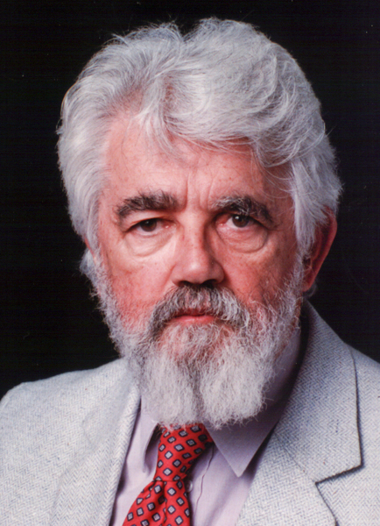
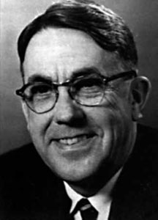
A bit of history…..
1950: Alan Turing discussed how to build intelligent machines and how to test their intelligence in his paper, “Computing Machinery and Intelligence”
Alan Turing
1955-56: Logic Theorist – the first AI program created by Herbert Simon, Allen Newell and John Shaw.
1956: The term artificial intelligence was first coined by John McCarthy
1958: McCarthy invented the computer programming language LISP
John McCarthy
1959: Arthur Samuel coined the term "machine learning”
Arthur Samuel

Slide 4
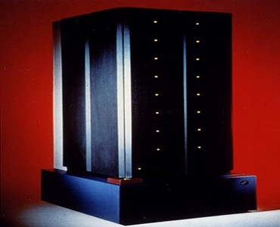
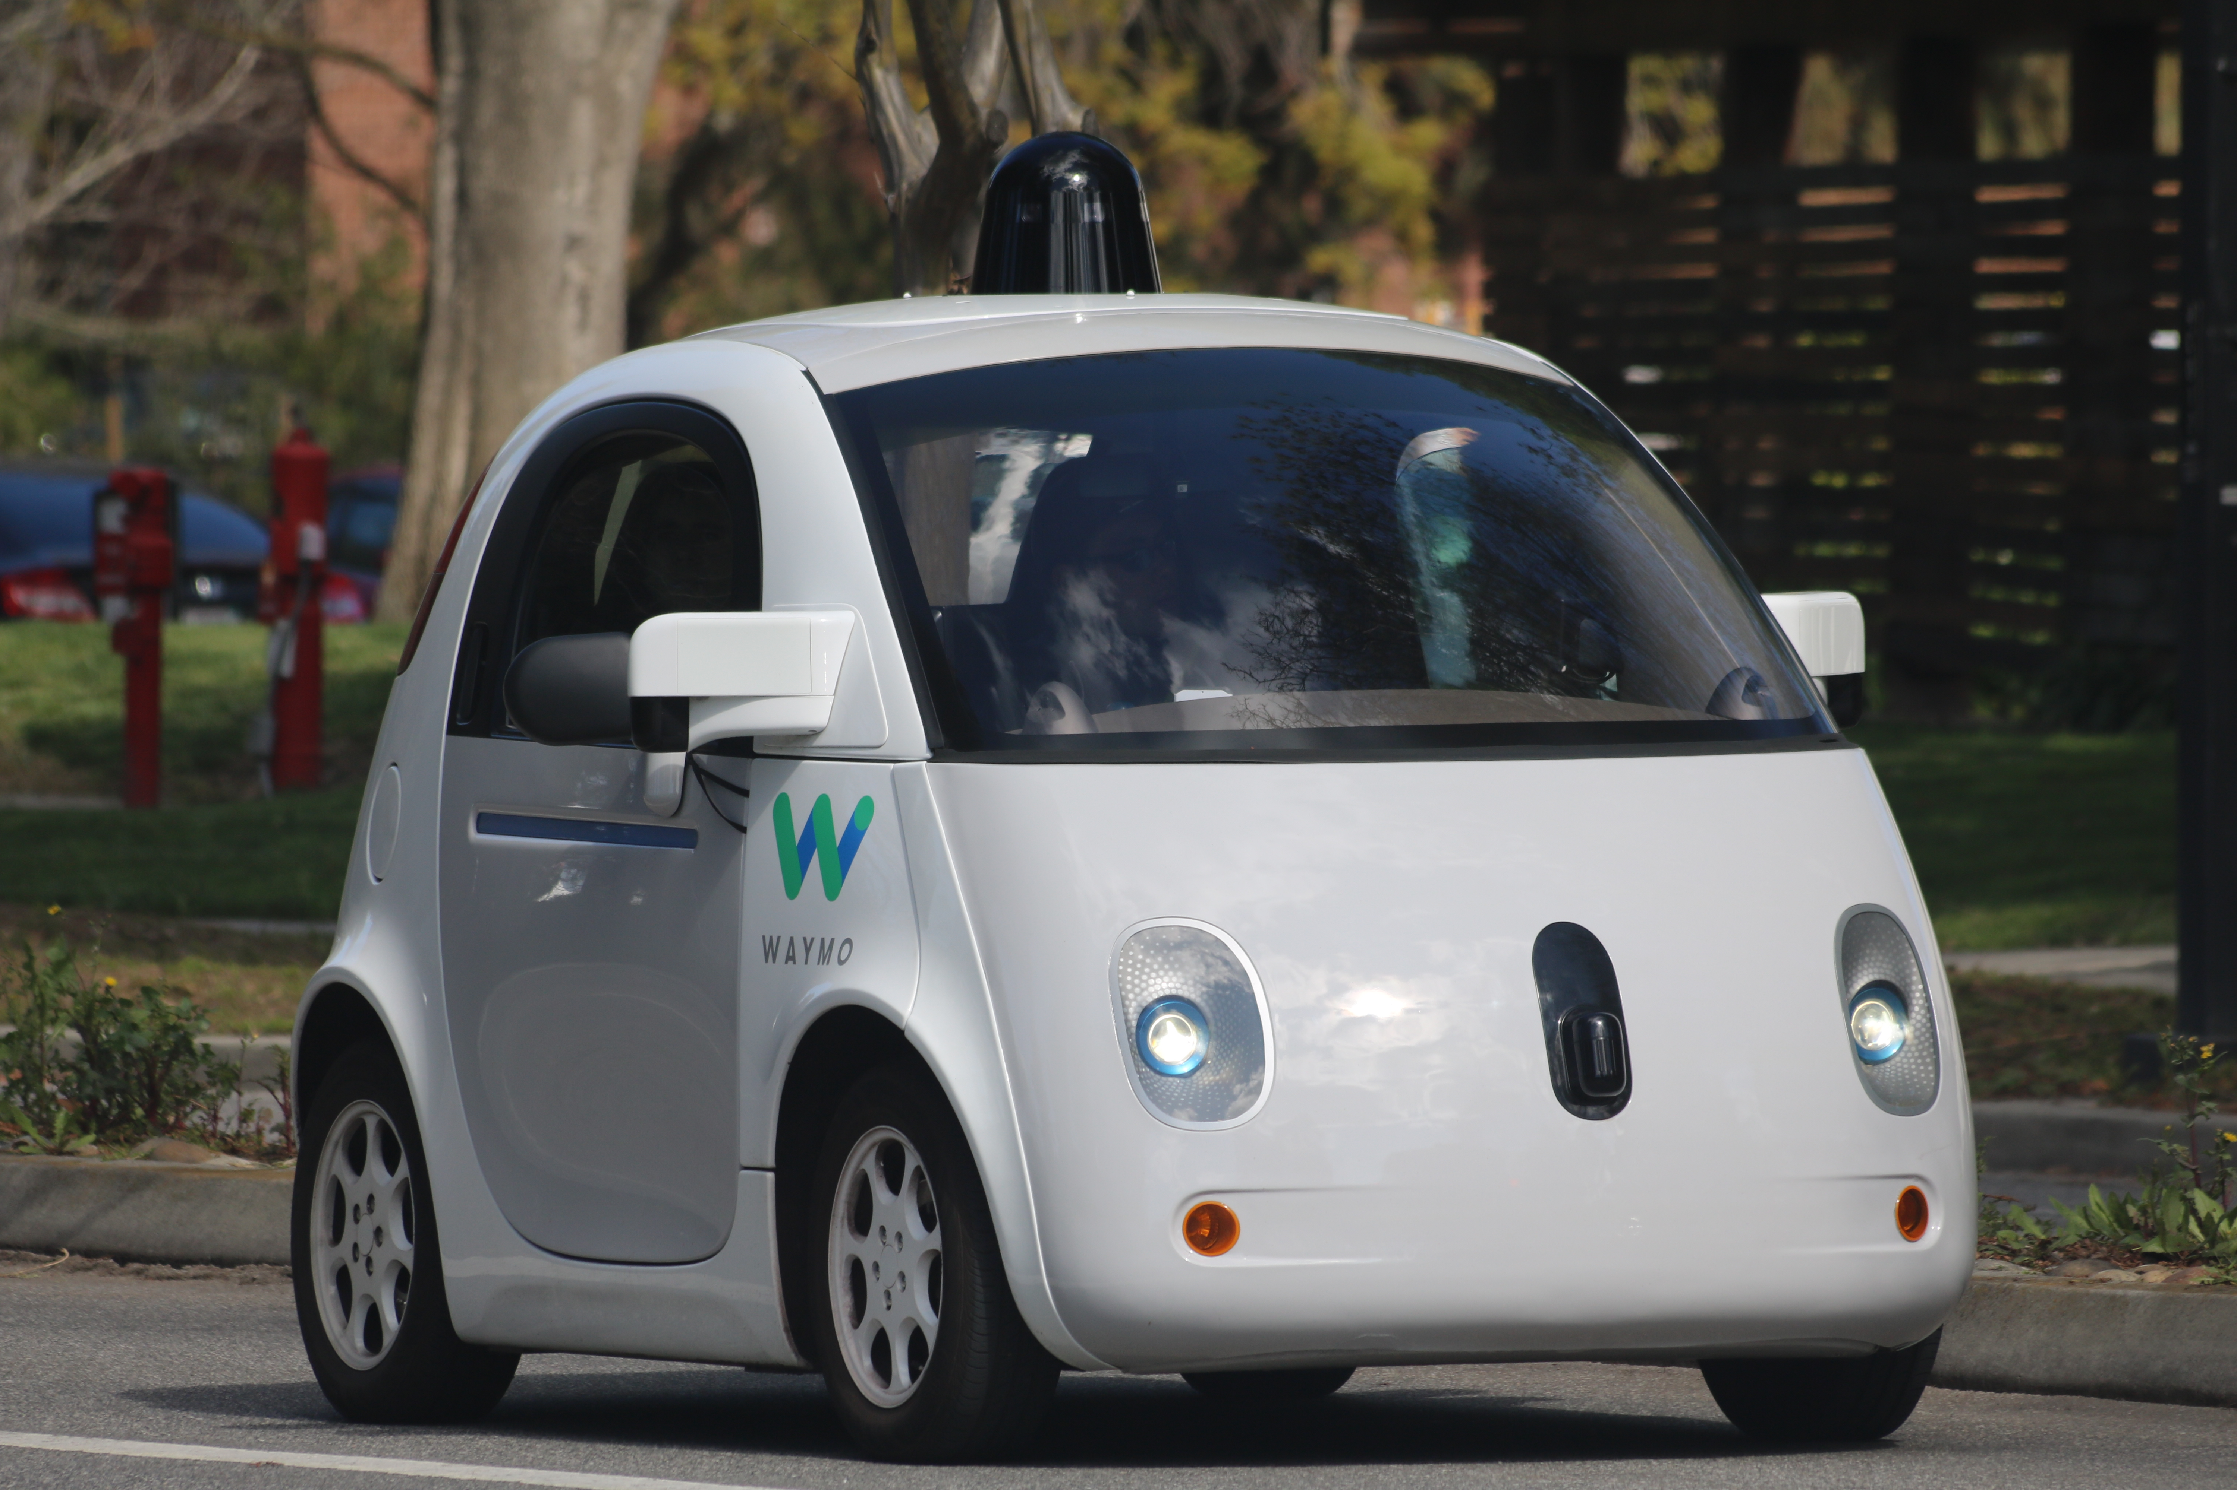
1997: IBM’s Deep Blue beats the world champion at chess
2009: Google begins testing a self-driving car
2011: IBM’s Watson beats its human competitors at Jeopardy
2011: Google Brain is developed
2014: Facebook develops DeepFace
2016: The AlphaGo algorithm developed by Google DeepMind wins the Go competition
Deep Blue
Waymo (Google) self-driving car
Notes:
Deep Blue: a system capable of examining 200 million moves per second, or 50 billion positions. [IBM]

Slide 5
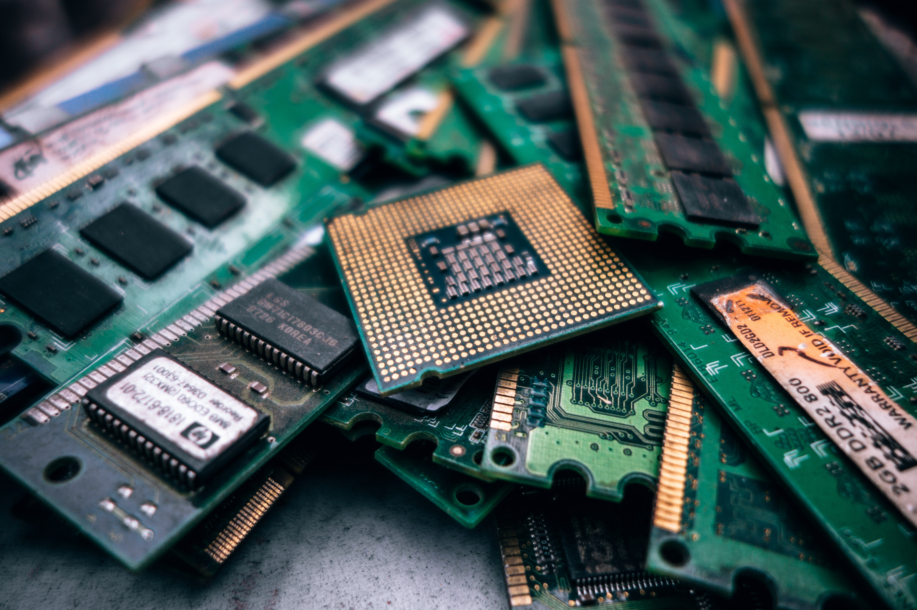

AI Renaissance: Why Now?
Computational power
Faster CPUs
GPUs (CUDA)
TPUs
In-memory computation
Distributed computing
Democratization of technology
Availability of data (Big Data)
Industry investments
Notes:
CUDA: Compute Unified Device Architecture, parallel processing architecture by Nvidia. CUDA Deep Neural Network library (cuDNN) is a GPU-accelerated library of primitives for deep neural networks.

Slide 6
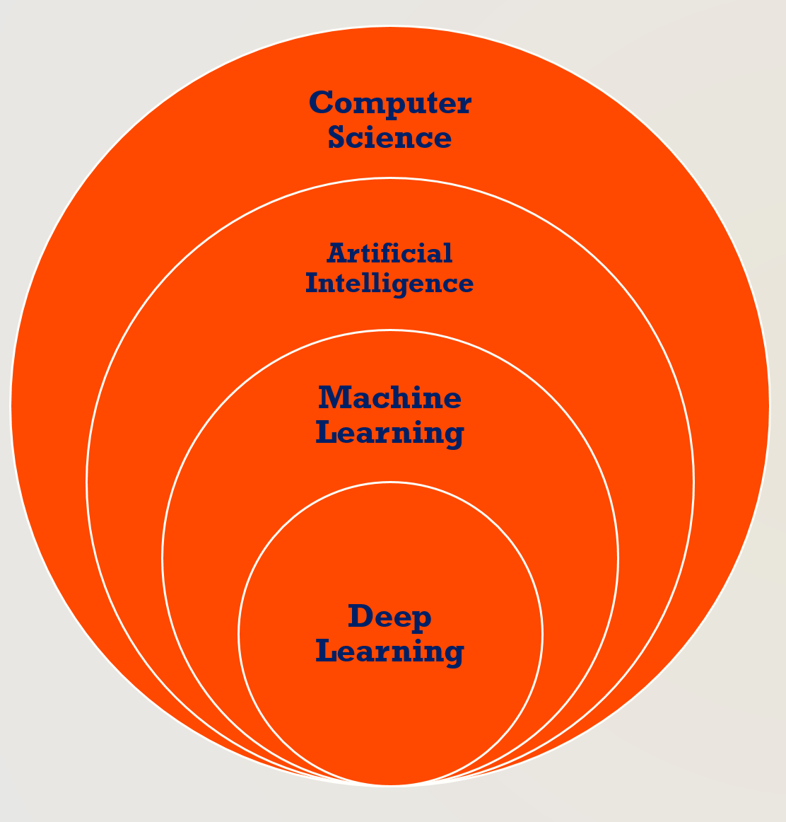
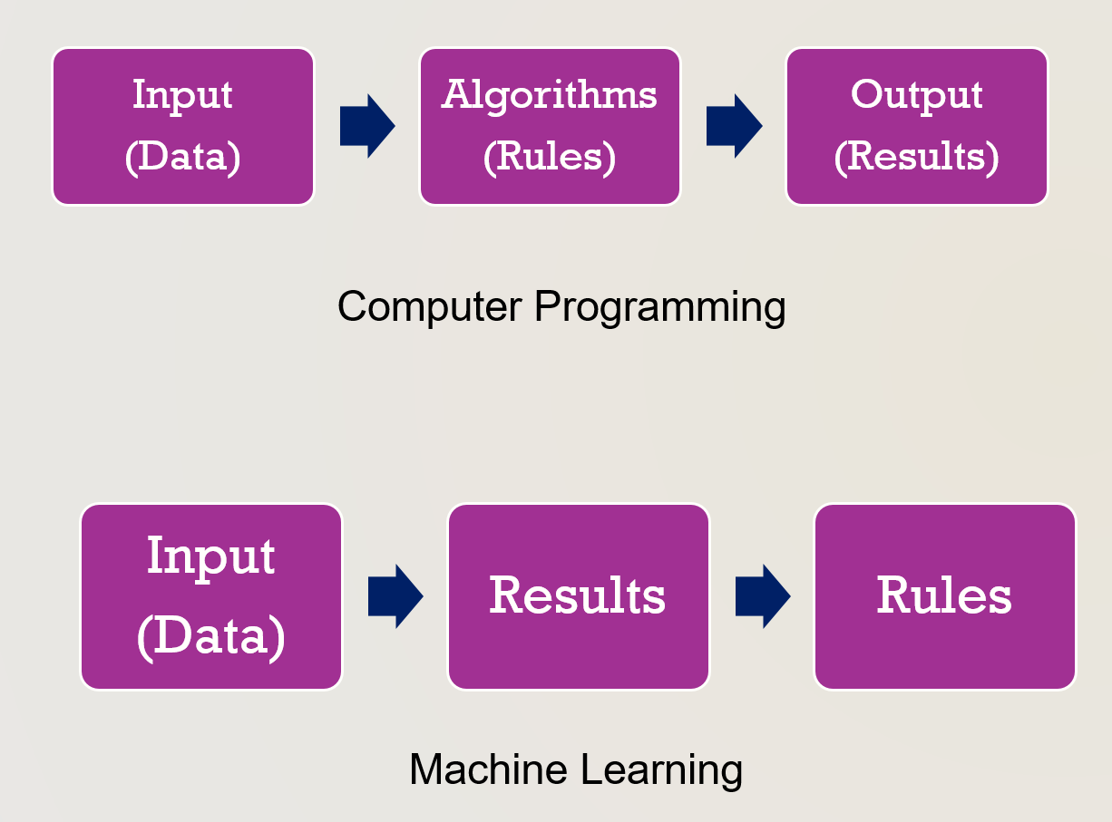
Artificial intelligence, machine learning, and deep learning
Artificial Intelligence (AI): an effort to automate intellectual tasks normally performed by humans.
Machine Learning (ML): could a computer automatically learn these rules by looking at data?
Deep Learning: a subfield of machine learning - a new take on learning representations (neural networks) from data that puts an emphasis on learning successive layers (deep) of increasingly meaningful representations.

Slide 7
Machine Learning
Machine Learning is the science (and art) of programming computers so they can learn from data.
“Machine Learning is the field of study that gives computers the ability to learn without being explicitly programmed.” —Arthur Samuel, 1959
Machine Learning shines for problems that either are too complex for traditional approaches or have no known algorithm. For example, speech recognition and image recognition.

Slide 8

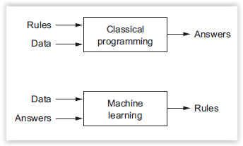
Machine Learning
Machine Learning: Creating and using models learned from data
Supervised Learning
Unsupervised Learning
Semi-supervised Learning
Reinforcement Learning

Slide 9
Machine Learning
Applying ML techniques to dig into large amounts of data can help discover patterns that were not immediately apparent. This is called data mining.
Machine Learning is great for:
Problems for which existing solutions require a lot of hand-tuning or long lists of rules: one Machine Learning algorithm can often simplify code and perform better.
Fluctuating environments: a Machine Learning system can adapt to new data.

Slide 10
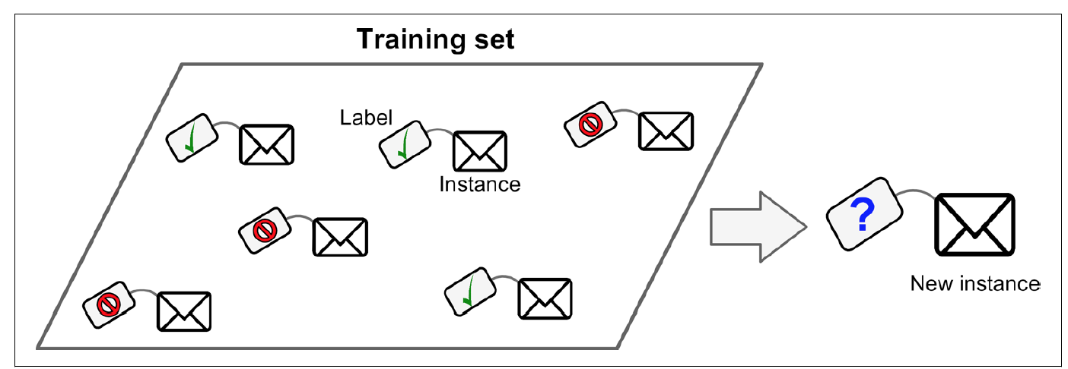
Supervised Learning
In supervised learning, the training data you feed to the algorithm includes the desired solutions, called labels.
A typical supervised learning task is classification. The spam filter is a good example of this: it is trained with many example emails along with their class (spam or not), and it must learn how to classify new emails.

Slide 11
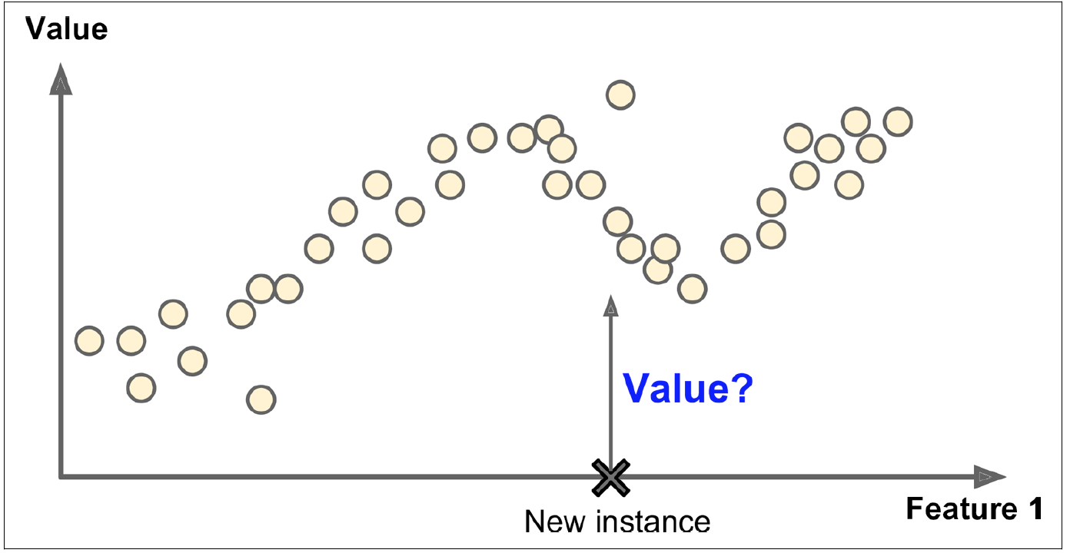
Supervised Learning
Another typical task is to predict a target numeric value, such as the price of a car, given a set of features (mileage, age, brand, etc.) called predictors. This sort of task is called regression.
To train the system, you need to give it many examples of cars, including both their predictors and their labels (i.e., their prices).

Slide 12
Supervised Learning Algorithms
Linear Regression
Logistic Regression
Support Vector Machines (SVMs)
Decision Trees
Random Forests
k-Nearest Neighbors
Neural networks
Note: Some neural networks can be unsupervised or semi-supervised.

Slide 13
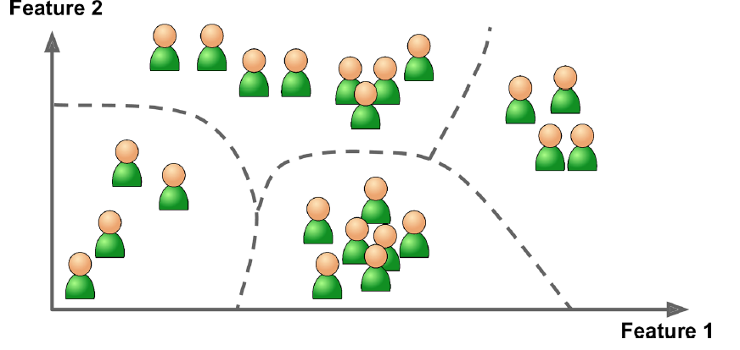
Unsupervised Learning
In unsupervised learning, as you might guess, the training data is unlabeled
The system tries to learn without a teacher.
Most common unsupervised learning is clustering
Clustering algorithms:
k-Means
Hierarchical Cluster Analysis (HCA)
Expectation Maximization

Slide 14
Reinforcement Learning
Reinforcement learning is most relevant for online control tasks , such as robot control and gameplaying.
An agent needs to learn a policy for how it should act in an environment in order to be rewarded. For instance should the robot move forward or backward or should the computer program move the pawn or take the Queen?
Unlike in supervised and unsupervised ML, the training and inference stages are interleaved and ongoing.
Applications in computer gaming (DeepMind)

Slide 15
Attributes & Features
In Machine Learning an attribute is a variable (e.g., “Mileage”), while a feature has several meanings depending on the context, but generally means an attribute plus its value (e.g., “Mileage =15,000”).
Many people use the words attribute and feature interchangeably, though.

Slide 16
Features
Feature Engineering: A critical part of the success of a Machine Learning project is coming up with a good set of features to train on.
Feature Selection: Selecting the most useful features to train on among existing features.
Feature Extraction: Combining existing features to produce a more useful one (dimensionality reduction algorithms can help).

Slide 17
Dimensionality Reduction
The goal is to simplify the data without losing too much information. One way to do this is to merge several correlated features into one.
For example, a car’s mileage may be very correlated with its age, so the dimensionality reduction algorithm will merge them into one feature that represents the car’s wear and tear. This is called feature extraction.
It is often a good idea to try to reduce the dimension of your training data using a dimensionality reduction algorithm before you feed it to another Machine Learning algorithm (such as a supervised learning algorithm). It will run much faster, the data will take up less disk and memory space, and in some cases it may also perform better.

Slide 18
Dimensionality Reduction
Principal component analysis (PCA) is an unsupervised machine learning algorithm that discovers relationships between variables and reduces variables down to a set of uncorrelated synthetic representations called principal components. Singular Value Decomposition (SVD) is commonly used for PCA.
Principal components contain all of the dataset's important information but do not include the noise, information redundancy and outliers that were present in the original data set.

Slide 19
PCA Example
For an example, imagine you work for a major grocery store chain and you've got some data that was generated by customers making purchases with their rewards card. The data set describes customers and the products they purchase.
You need to identify what key factors, perhaps like age or income, that most affect the customer's purchasing behavior. You can use PCA to decompose your customer purchasing data into one vector that describes the factors that influence the customers' purchasing behavior and another vector that describes the probabilities that products will be purchased based on those key influencing factors. Principal components are synthetic representations of a data set.

Slide 20
Challenges of Machine Learning
Insufficient quantity of training data
Poor quality Data
Overfitting the training data
Under fitting the training data
Irrelevant features

Slide 21
Overfitting
It means that the model performs well on the training data, but it does not generalize well.
Overfitting happens when the model is too complex relative to the amount and noisiness of the training data. The possible solutions are:
To simplify the model by selecting one with fewer parameters (e.g., a linear model rather than a high-degree polynomial model), by reducing the number of attributes in the training data or by constraining the model
To gather more training data
To reduce the noise in the training data (e.g., fix data errors and remove outliers)
One of the ways of avoiding overfitting is using cross validation (k-fold validation)
Constraining a model to make it simpler and reduce the risk of overfitting is called regularization (a form of regression that shrinks the coefficient estimates for least important variables towards zero)

Slide 22
Clustering
K-means clustering is an unsupervised machine learning algorithm that you can use to predict subgroups from within a dataset.
With k-means clustering, you usually have an idea of how many subgroups are appropriate. With a k-means model, predictions are based on:
the number of cluster centers that are present
the nearest mean values between observations.
The “cluster center” is the arithmetic mean of all the points belonging to the cluster.
Each point is closer to its own cluster center than to other cluster centers.

Slide 23
Clustering
Based on expectation–maximization algorithm
Different initializations may result in different clusters
Need to run the algorithms multiple times to find optimal clusters (newer algorithm: Kmeans++)
Requirement: scale your variables before clustering your data

Slide 24
Use Cases for Clustering
Cost modeling
Customer segmentation
Hedge fund classification
Insurance claim fraud detection

